Slide 1
Tag the Art
Aditya Jagdev

Slide 2
Problem Definition
Given is a set of labelled images of art belonging to different art categories
A classifier needs to be built which should classify unseen images of art into their correct categories.
It is assumed that the images contain the most significant features (of their category) as the main subject in the image
Therefore, the given problem is reduced to an image classification problem.

Slide 3
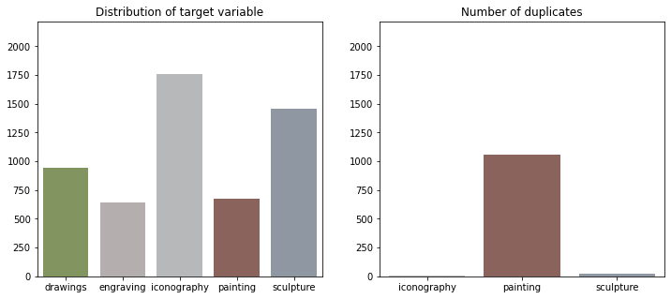
Solution Overview
After cleaning the data by rejecting non image files and converting them all to RGB format, training was carried out.

Slide 4
Solution Overview
PCA did not show linear separability.
CNN, VGG16 and ResNet50 were used to see which model works best.
Cross validation was used for selecting the best hyperparameters to improve performance of the converged model.

Slide 5
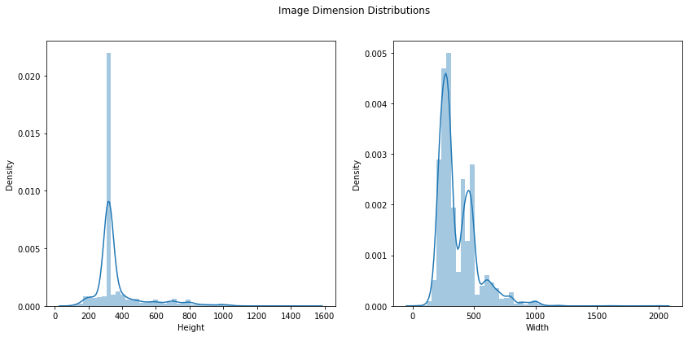
High level approach
The finalized model was a VGG16 model, fine tuned by only freezing the first 3 conv blocks. The input size was set to 360x360 as it was most suitable to this use case.

Slide 6
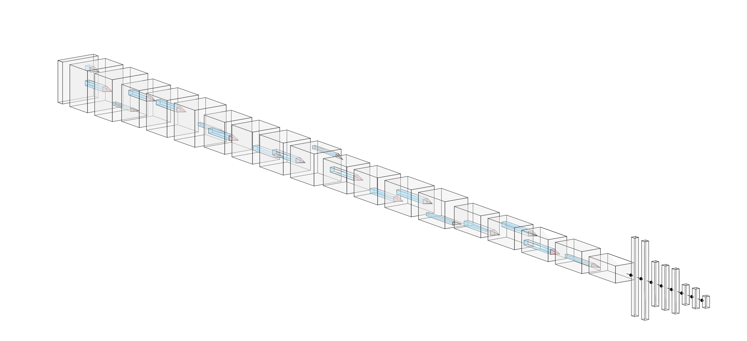
High level approach
The finalized model was a VGG16 model, fine tuned by only freezing the first 3 conv blocks. The input size was set to 360x360 as it was most suitable to this use case.

Slide 7
High level approach
Data generator used applied the following transformations:
Norm
Rotation: ±15°
Width and height shift: ±10%
Shear: ±15%
Zoom: ±20%
Horizontal Flip
Fill Mode: Reflect
Brightness Adjustment: -30% to +15%

Slide 8
High level approach
After the training and validation losses converged, instead of letting the model simmer for a few epochs, training was stopped.
Cross validation was used to tweak the class weights along with lower learning rates than the trend followed by ReduceLROnPlateau.
CNN was rejected due to inability to learn. It got stuck at 54% accuracy on the validation set.
ResNet50 was rejected due to significantly higher training times and slow convergence.

Slide 9
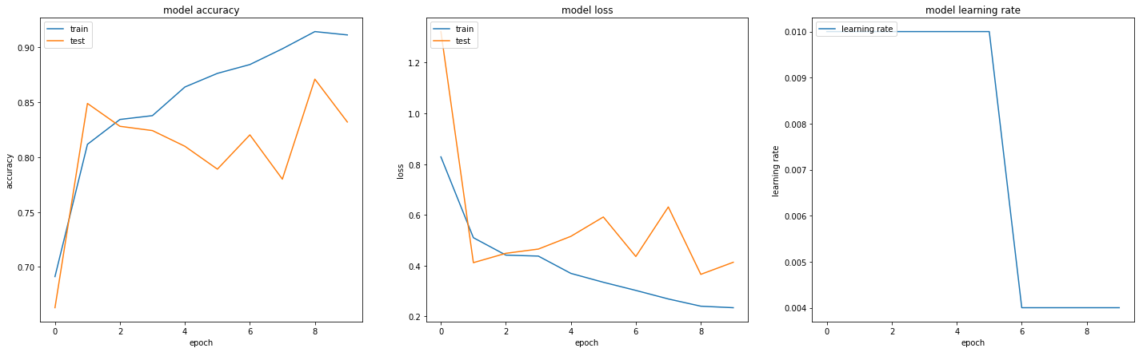
VGG16 FT First 10 Epochs

Slide 10
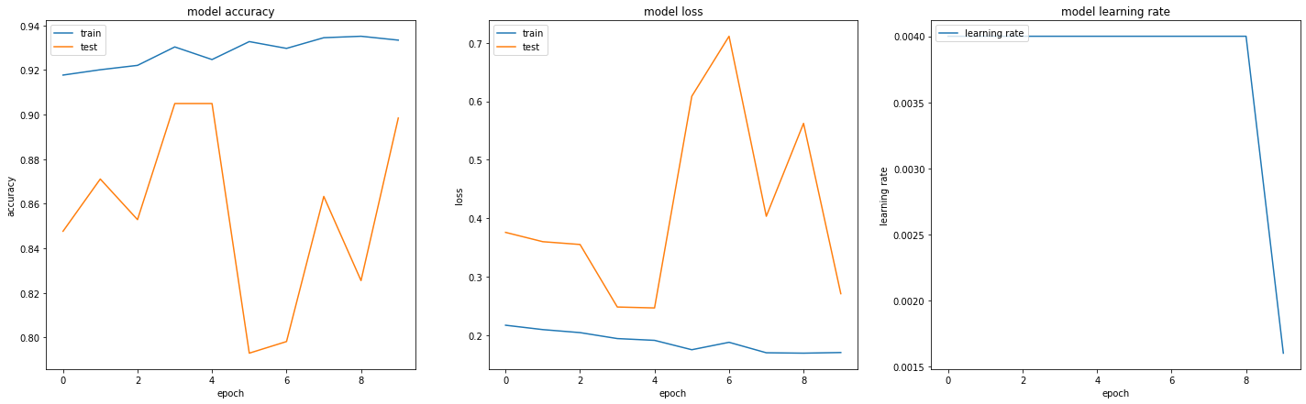
VGG16 FT Epochs 11-20

Slide 11
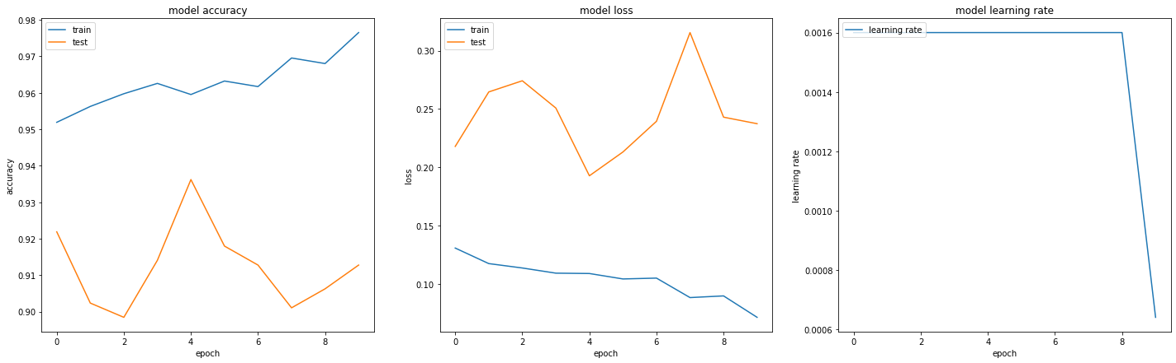
VGG16 FT Epochs 21-30

Slide 12
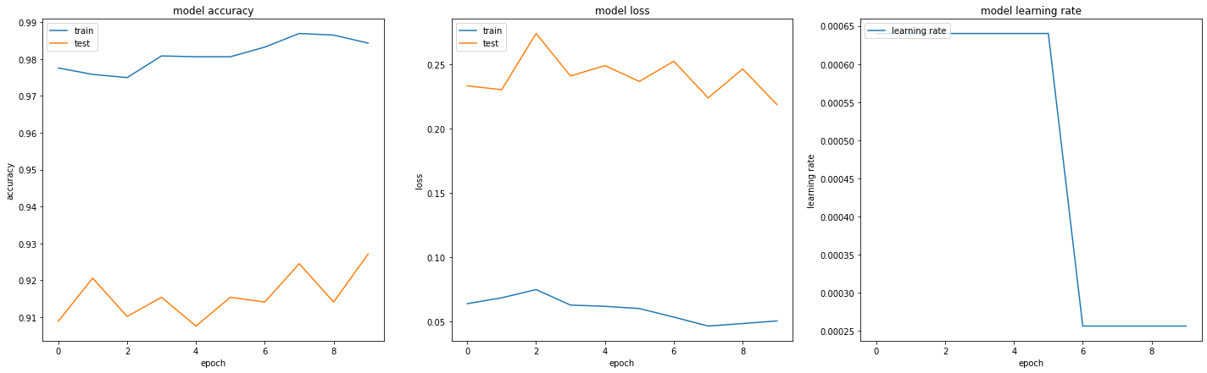
VGG16 FT Epochs 31-40

Slide 13
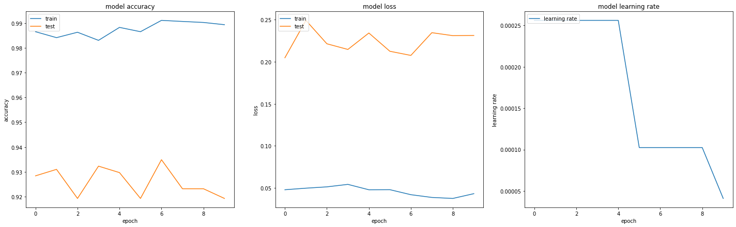
VGG16 FT Epochs 41-50

Slide 14
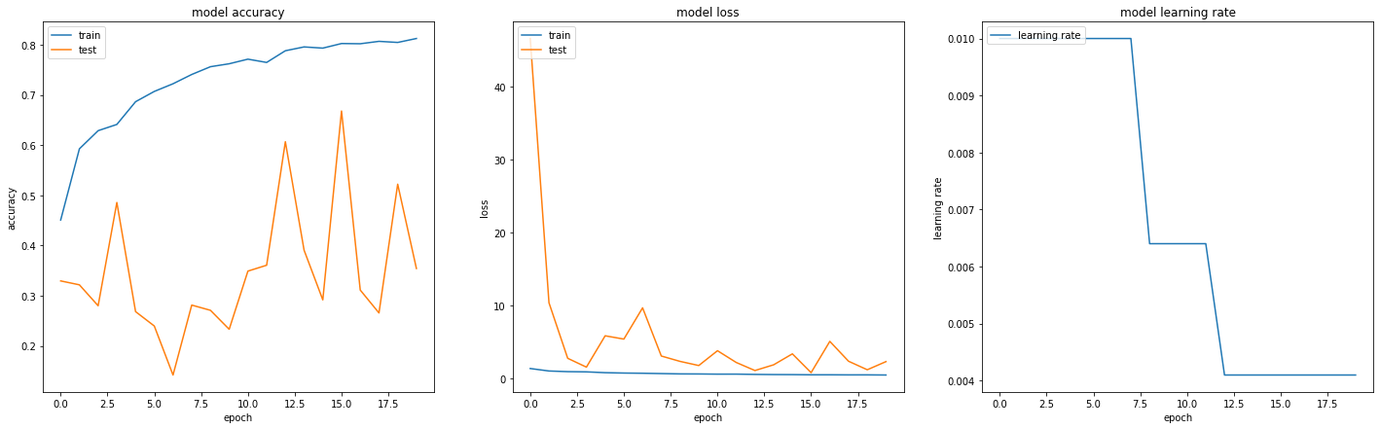
ResNet50 First 20 Epochs

Slide 15
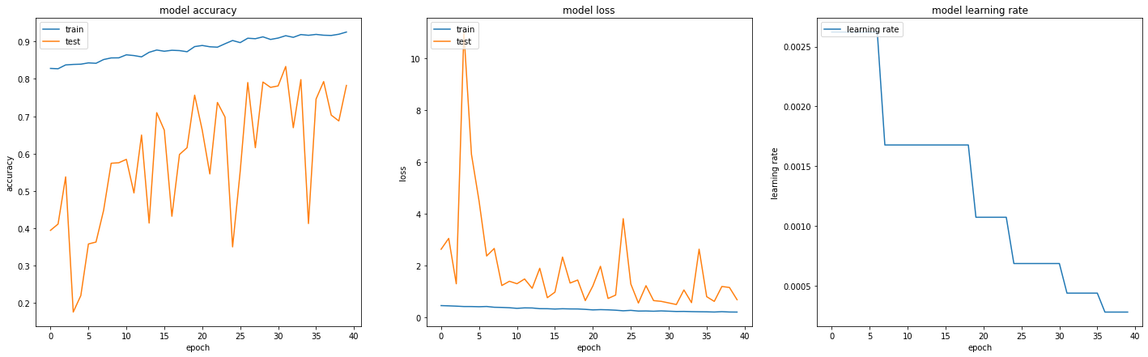
ResNet50 Epochs 21-60

Slide 16
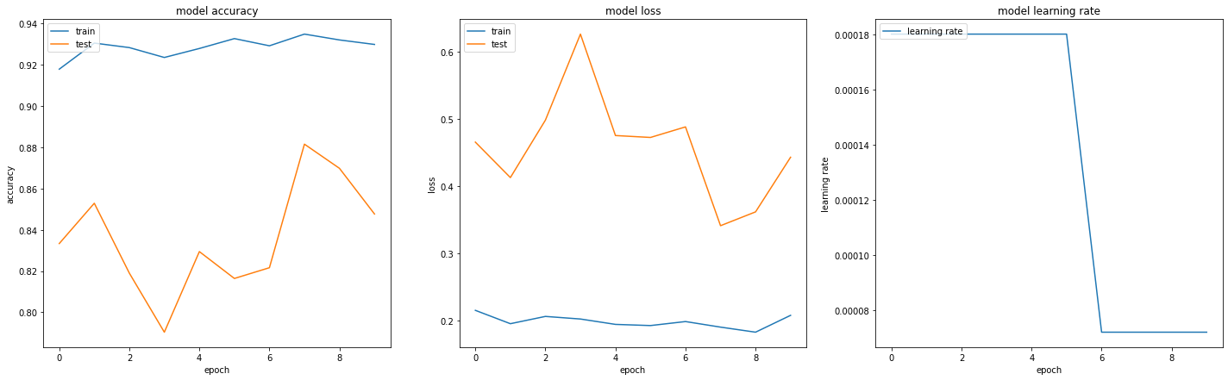
ResNet50 Epochs 61-70

Slide 17
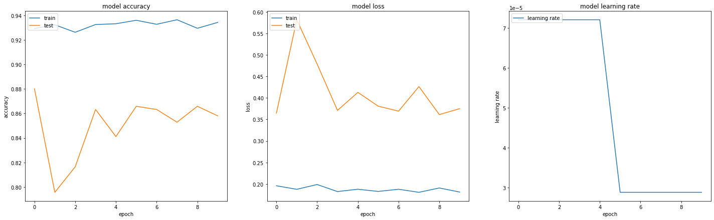
ResNet50 Epochs 71-80

Slide 18
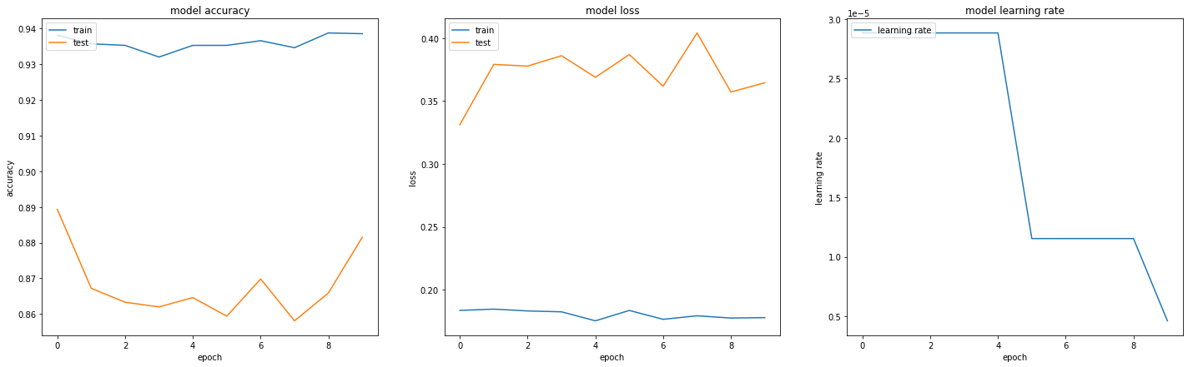
ResNet50 Epochs 81-90

Slide 19
Steps involved in solving the problem
No external datasets were used. Instead data augmentation using ImageDataGenerator transforms was used.
As a first step, PCA was carried out to see if the data had linear separability.
Although some images in ‘sculpture’ and ‘iconography’ were found to have features with separable principal components, most other images belonging to the same category and all of the images belonging to the other categories were not linearly separable.

Slide 20
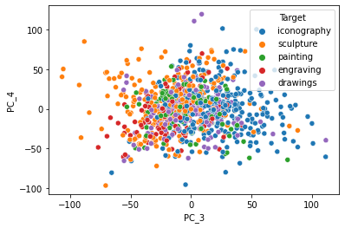
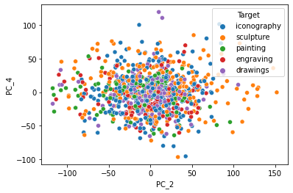
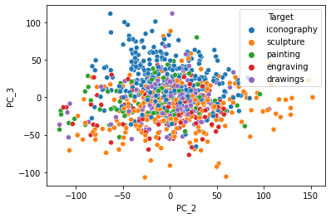
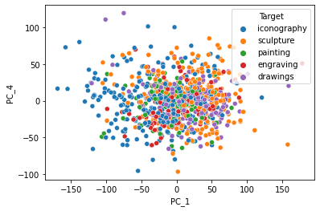

Slide 21
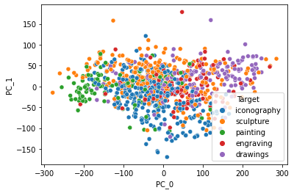
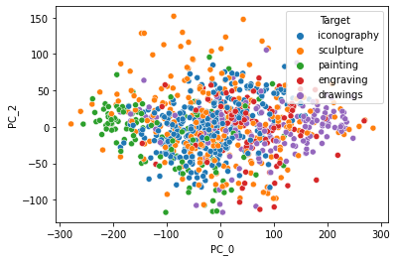
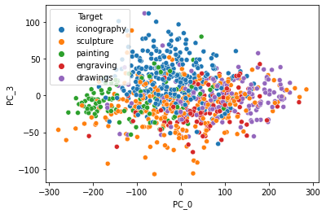
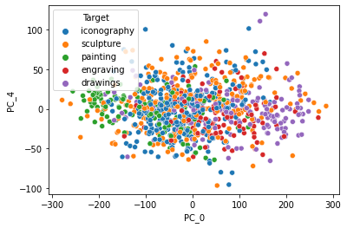

Slide 22
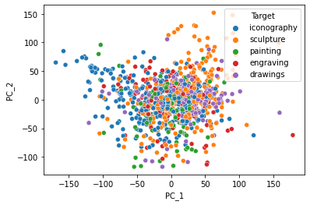
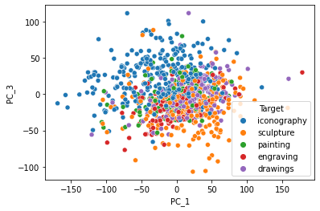

Slide 23
Regarding PCA
After noticing that some images consistently had their PC_x among those of other categories, it was concluded that the images had similar features or had the incorrect label.
After going through the dataset, it was inferred that both former and latter were true. The dataset contained images that were similar and images that were mislabeled.
As the number of misclassified images were less in number compared to the correctly classified images (but still too many for manual intervention), it was decided to train the model only till the point the losses converge.

Slide 24
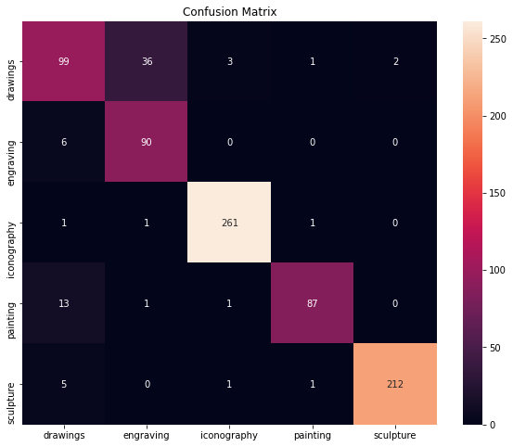
Steps involved in solving the problem
For the final prediction, only a single VGG16 model’s outputs were used.
The confusion matrix for the best model is presented.
Drawings were most often misclassified, as an engraving.
After this, Shapley explanations were plotted.

Slide 25
Steps involved in solving the problem
Due to memory constraints, only 480 stratified images were used as background for SHAP.
Still, some interesting information was uncovered in case of iconography, painting and sculpture.

Slide 26
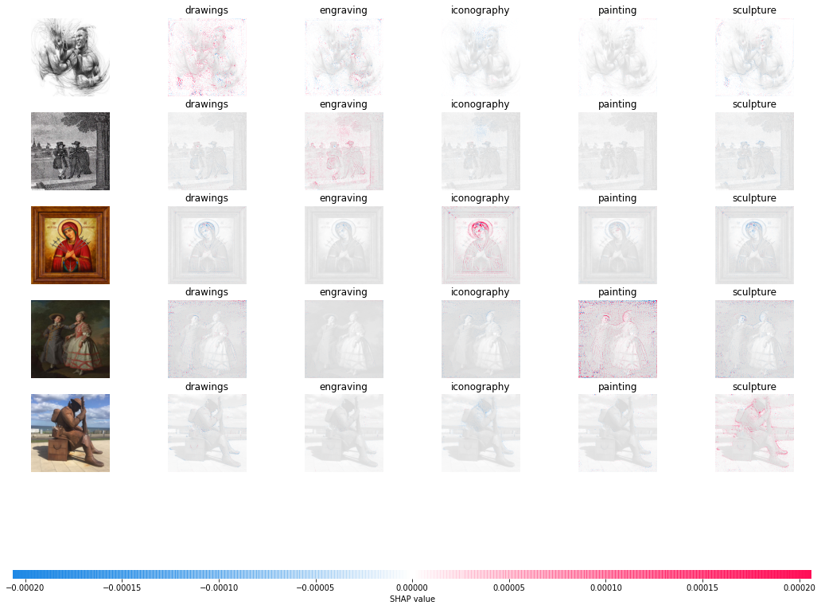

Slide 27
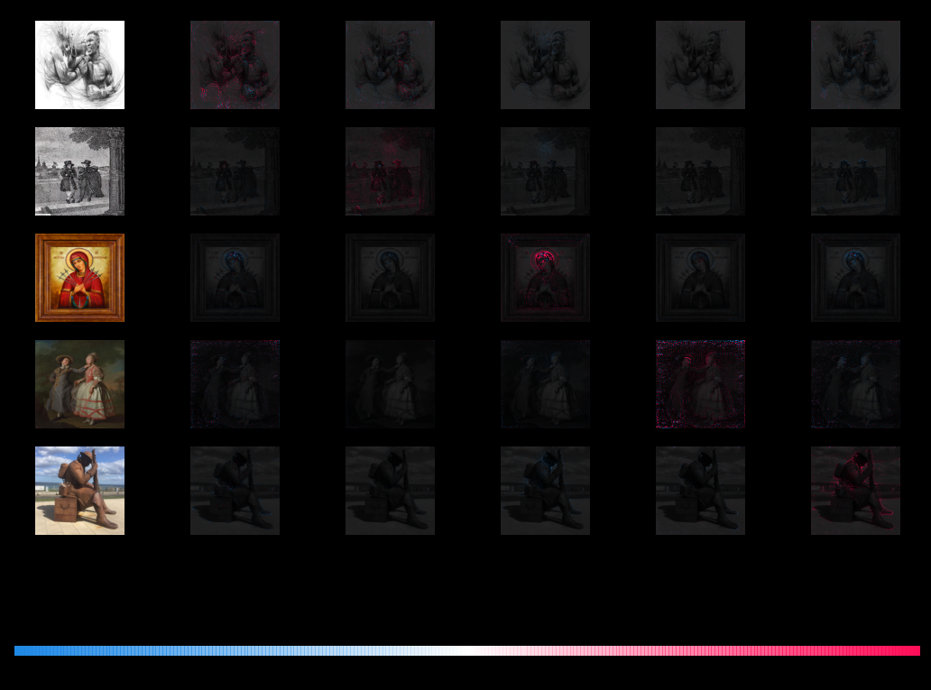

Slide 28
Steps involved in solving the problem
Convolution filters were plotted to understand what kind of features were being looked at by the model.
Layer 1 filters are presented.
It largely looks like edge detection filters, but also contains some color detectors.
These may have assisted in separating drawings and engravings from the other categories.
Note that green and cyan colors are most abundantly found in sculpture images.

Slide 29
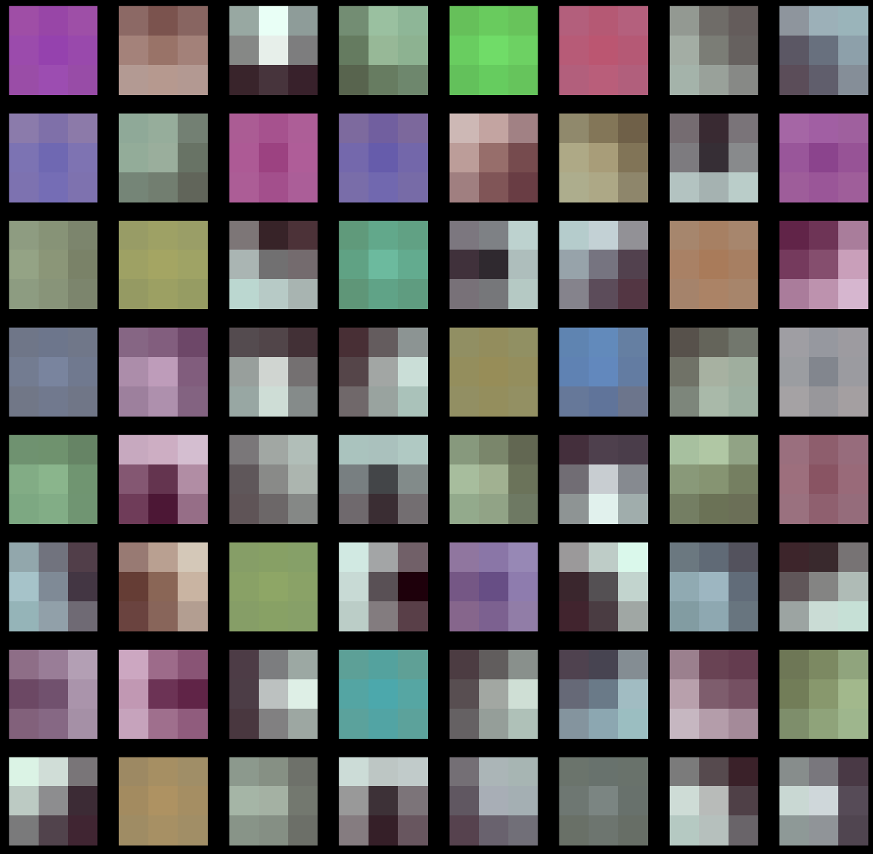

Slide 30
Final Outcome
Classification was carried out for iconography, paintings and sculptures with high degree of certainty.
The model misclassified about a third of the drawings in test set as engravings.
In order to find out what led to this misclassification, Shapley explanations for some of the 36 images needs to be carried out.
Understanding which layers are causing this misclassification may also aid in understanding where the model is breaking. Again, Shapley explanations will be used for the same.

Slide 31
Value delivered to business
The Louvre museum can now focus solely on finding a person good at tagging drawings. They will save costs by not looking to hire an expert who would be able to deal with all the classes.
A step in the right direction, the museum can now perform A/B testing to find which paintings/types of art have the highest user (the person looking at the art website) retention rate. This would allow them to understand which paintings are best used in advertisements or marketing.
This will also assist in creating organic visitor pathways in the museum to guide the visitors without aid and strategically place paintings and merch stores.

Slide 32
Additional things that can be added
With more compute, Shapley explanations would be given much faster and with higher confidence.
Expectation maximization would be carried out in order to further understand what features the model has captured.
The current VGG16 model requires 3GB of GPU memory to deploy. A Tensorflow serving compatible simple_save file option has not yet been explored due to time constraints.
A gamified web app would allow users to learn more about art. An option may be added for them to upload art paste a URL to know it’s category. This would allow more training data to be gathered.

Slide 33
fin

